Slide 1
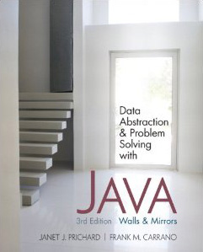
Chapter 5 (continued)
Linked Lists
© 2011 Pearson Addison-Wesley. All rights reserved
5 B-<number>

Slide 2
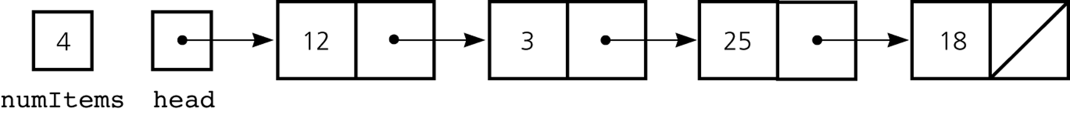
A Reference-Based Implementation of the ADT List
A reference-based implementation of the ADT list
  Does not shift items during insertions and deletions
  Does not impose a fixed maximum length on the list
Figure 5-18
A reference-based implementation of the ADT list
© 2011 Pearson Addison-Wesley. All rights reserved
5 B-<number>

Slide 3
A Reference-Based Implementation of the ADT List
Default constructor
  Initializes the data fields numItems and head
List operations
  Public methods
    isEmpty
    size
    add
    remove
    get
    removeAll
  Private method
    find
© 2011 Pearson Addison-Wesley. All rights reserved
5 B-<number>

Slide 4
Comparing Array-Based and Referenced-Based Implementations
Size
  Array-based
    Fixed size
      Issues
        Can you predict the maximum number of items in the ADT?
        Will an array waste storage?
      Resizable array
        Increasing the size of a resizable array can waste storage and time
© 2011 Pearson Addison-Wesley. All rights reserved
5 B-<number>

Slide 5
Comparing Array-Based and Referenced-Based Implementations
Size (Continued)
  Reference-based
    Do not have a fixed size
      Do not need to predict the maximum size of the list
      Will not waste storage
Storage requirements
  Array-based
    Requires less memory than a reference-based implementation
      There is no need to store explicitly information about where to find the next data item
© 2011 Pearson Addison-Wesley. All rights reserved
5 B-<number>

Slide 6
Comparing Array-Based and Referenced-Based Implementations
Storage requirements (Continued)
  Reference-based
    Requires more storage
      An item explicitly references the next item in the list
Access time
  Array-based
    Constant access time
  Reference-based
    The time to access the i^{th} node depends on i
© 2011 Pearson Addison-Wesley. All rights reserved
5 B-<number>

Slide 7
Comparing Array-Based and Referenced-Based Implementations
Insertion and deletions
  Array-based
    Require you to shift the data
  Reference-based
    Do not require you to shift the data
    Require a list traversal
© 2011 Pearson Addison-Wesley. All rights reserved
5 B-<number>

Slide 8
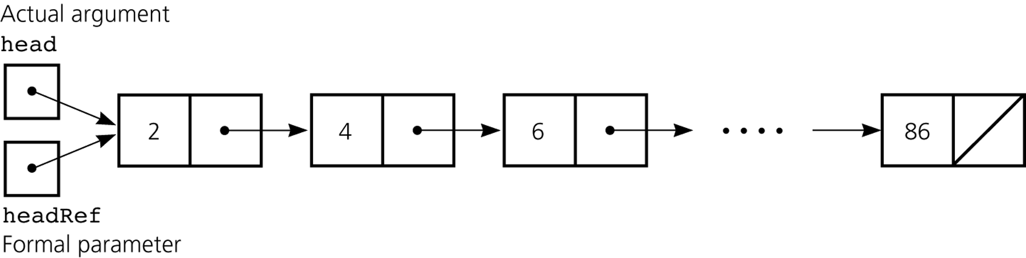
Passing a Linked List to a Method
A method with access to a linked list’s head reference has access to the entire list
When head is an actual argument to a method, its value is copied into the corresponding formal parameter
Figure 5-19
A head reference as an argument
© 2011 Pearson Addison-Wesley. All rights reserved
5 B-<number>

Slide 9
Processing Linked Lists Recursively
Traversal
  Recursive strategy to display a list
    Write the first node of the list
    Write the list minus its first node
  Recursive strategies to display a list backward
    writeListBackward strategy
      Write the last node of the list
      Write the list minus its last node backward
    writeListBackward2 strategy
      Write the list minus its first node backward
      Write the first node of the list
© 2011 Pearson Addison-Wesley. All rights reserved
5 B-<number>

Slide 10
Processing Linked Lists Recursively
Insertion
  Recursive view of a sorted linked list
    The linked list that head references is a sorted linked list if
    head is null (the empty list is a sorted linked list)
    or
    head.next is null (a list with a single node is a
    sorted linked list)
    or
    head.item < head.next.item,
    and head.next references a sorted linked list
© 2011 Pearson Addison-Wesley. All rights reserved
5 B-<number>

Slide 11
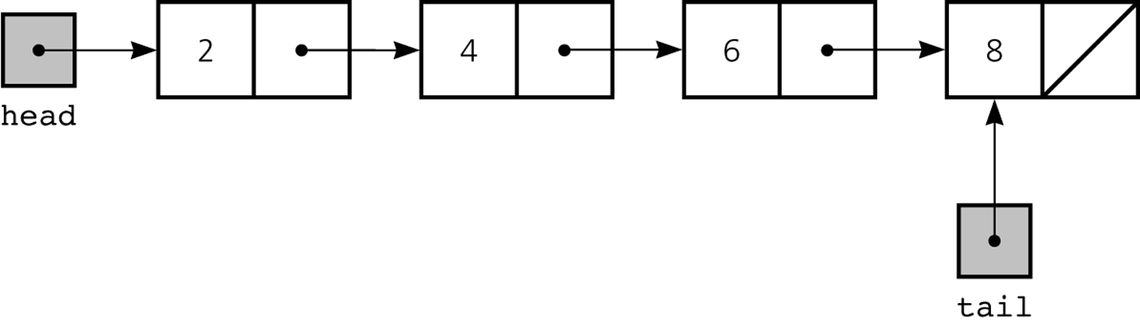
Variations of the Linked List:
Tail References
tail references
  Remembers where the end of the linked list is
  To add a node to the end of a linked list
    tail.next = new Node(request, null);
Figure 5-22
A linked list with head and tail references
© 2011 Pearson Addison-Wesley. All rights reserved
5 B-<number>

Slide 12
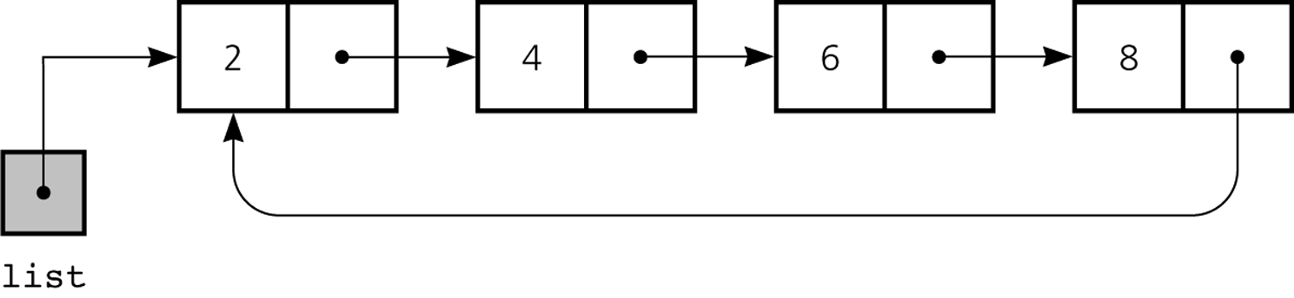
Circular Linked List
Last node references the first node
Every node has a successor
Figure 5-23
A circular linked list
© 2011 Pearson Addison-Wesley. All rights reserved
5 B-<number>

Slide 13
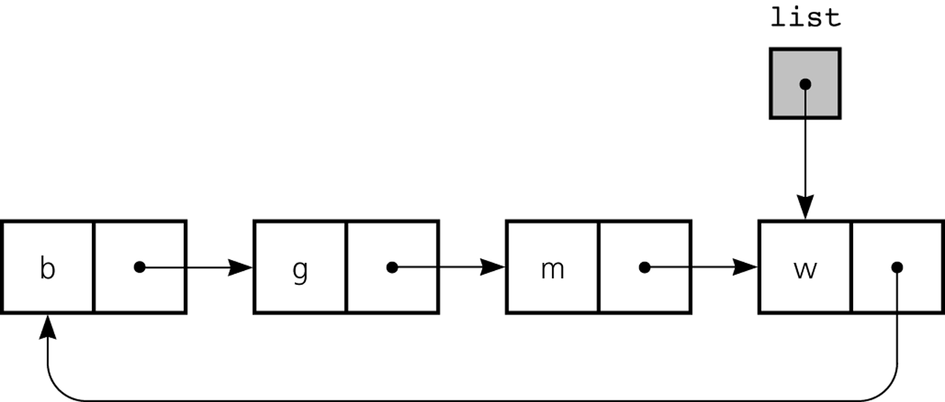
Circular Linked List
Figure 5-24
A circular linked list with an external reference to the last node
© 2011 Pearson Addison-Wesley. All rights reserved
5 B-<number>

Slide 14
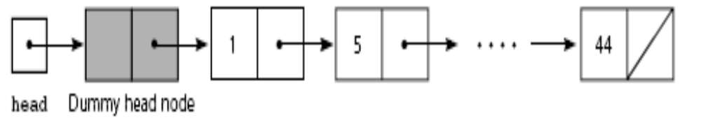
Dummy Head Nodes
Dummy head node
  Always present, even when the linked list is empty
  Insertion and deletion algorithms initialize prev to reference the dummy head node, rather than null
Figure 5-25
A dummy head node
© 2011 Pearson Addison-Wesley. All rights reserved
5 B-<number>

Slide 15
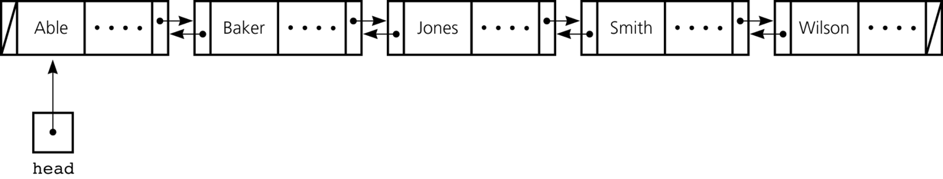
Doubly Linked List
Each node references both its predecessor and its successor
Dummy head nodes are useful in doubly linked lists
Figure 5-26
A doubly linked list
© 2011 Pearson Addison-Wesley. All rights reserved
5 B-<number>

Slide 16
Doubly Linked List
Circular doubly linked list
  preceding reference of the dummy head node references the last node
  next reference of the last node references the dummy head node
  Eliminates special cases for insertions and deletions
© 2011 Pearson Addison-Wesley. All rights reserved
5 B-<number>

Slide 17
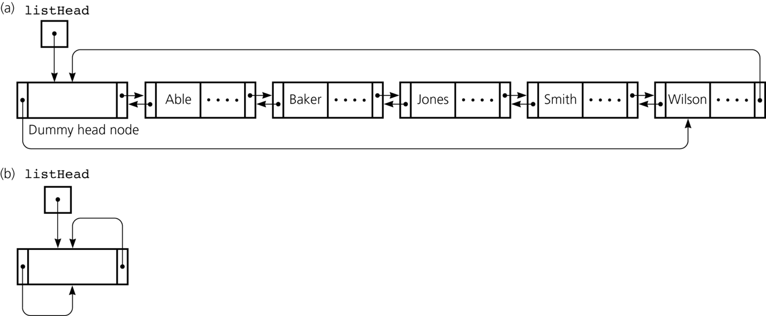
Doubly Linked List
Figure 5-27
a) A circular doubly linked list with a dummy head node; b) an empty list with a dummy head node
© 2011 Pearson Addison-Wesley. All rights reserved
5 B-<number>

Slide 18
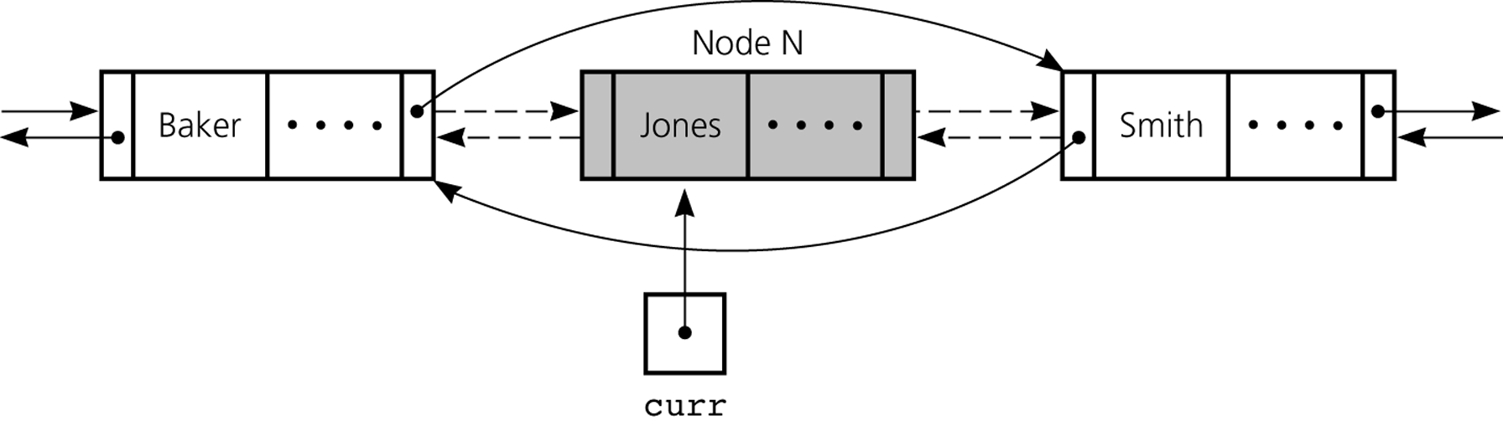
Doubly Linked List
To delete the node that curr references
  curr.preceding.next = curr.next;
  curr.next.preceding = curr.preceding;
Figure 5-28
Reference changes for deletion
© 2011 Pearson Addison-Wesley. All rights reserved
5 B-<number>

Slide 19
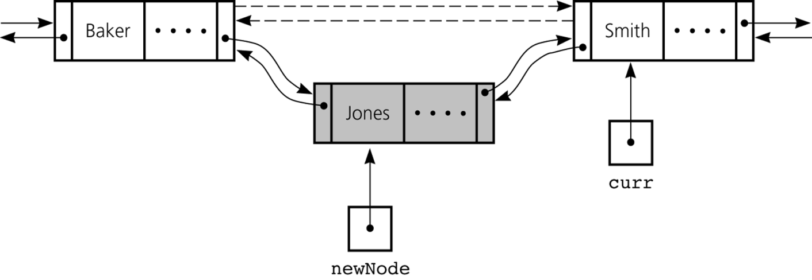
Doubly Linked List
To insert a new node that newNode references before the node referenced by curr
  newNode.next = curr;
  newNode.preceding = curr.preceding;
  curr.preceding = newNode;
  newNode.preceding.next = newNode;
Figure 5-29
Reference changes for insertion
© 2011 Pearson Addison-Wesley. All rights reserved
5 B-<number>

Slide 20
Application: Maintaining an Inventory
Stages of the problem-solving process
  Design of a solution
  Implementation of the solution
  Final set of refinements to the program
Operations on the inventory
  List the inventory in alphabetical order by title (L command)
  Find the inventory item associated with title (I, M, D, O, and S commands)
  Replace the inventory item associated with a title (M, D, R, and S commands)
  Insert new inventory items (A and D commands)
© 2011 Pearson Addison-Wesley. All rights reserved
5 B-<number>

Slide 21
The Java Collections Framework
Implements many of the more commonly used ADTs
Collections framework
  Unified architecture for representing and manipulating collections
  Includes
    Interfaces
    Implementations
    Algorithms
© 2011 Pearson Addison-Wesley. All rights reserved
5 B-<number>

Slide 22
Generics
JCF relies heavily on Java generics
Generics
  Develop classes and interfaces and defer certain data-type information
    Until you are actually ready to use the class or interface
Definition of the class or interface is followed by <E>
  E represents the data type that client code will specify
© 2011 Pearson Addison-Wesley. All rights reserved
5 B-<number>

Slide 23
Iterators
Iterator
  Gives the ability to cycle through items in a collection
  Access next item in a collection by using iter.next()
JCF provides two primary iterator interfaces
  java.util.Iterator
  java.util.ListIterator
Every ADT collection in the JCF have a method to return an iterator object
© 2011 Pearson Addison-Wesley. All rights reserved
5 B-<number>

Slide 24
Iterators
ListIterator methods
  void add(E o)
  boolean hasNext()
  boolean hasPrevious()
  E next()
  int nextIndex()
  E previous()
  int previousIndex()
  void remove()
  void set(E o)
© 2011 Pearson Addison-Wesley. All rights reserved
5 B-<number>

Slide 25
The Java Collection’s Framework List Interface
JCF provides an interface java.util.List
List interface supports an ordered collection
  Also known as a sequence
Methods
  boolean add(E o)
  void add(int index, E element)
  void clear()
  boolean contains(Object o)
  boolean equals(Object o)
  E get(int index)
  int indexOf(Object o)
© 2011 Pearson Addison-Wesley. All rights reserved
5 B-<number>

Slide 26
The Java Collection’s Framework List Interface
Methods (continued)
  boolean isEmpty()
  Iterator<E> iterator()
  ListIterator<E> listIterator()
  ListIterator<E> listIterator(int index)
  E remove(int index)
  boolean remove(Object o)
© 2011 Pearson Addison-Wesley. All rights reserved
5 B-<number>

Slide 27
The Java Collection’s Framework List Interface
Methods (continued)
  E set(int index, E element)
  int size()
  List<E> subList(int fromIndex, int toIndex)
  Object[] toArray()
© 2011 Pearson Addison-Wesley. All rights reserved
5 B-<number>

Slide 28
Summary
Reference variables can be used to implement the data structure known as a linked list
Each reference in a linked list is a reference to the next node in the list
Algorithms for insertions and deletions in a linked list involve
  Traversing the list from the beginning until you reach the appropriate position
  Performing reference changes to alter the structure of the list
© 2011 Pearson Addison-Wesley. All rights reserved
5 B-<number>

Slide 29
Summary
Inserting a new node at the beginning of a linked list and deleting the first node of a linked list are special cases
An array-based implementation uses an implicit ordering scheme; a reference-based implementation uses an explicit ordering scheme
Any element in an array can be accessed directly; you must traverse a linked list to access a particular node
Items can be inserted into and deleted from a reference-based linked list without shifting data
© 2011 Pearson Addison-Wesley. All rights reserved
5 B-<number>

Slide 30
Summary
The new operator can be used to allocate memory dynamically for both an array and a linked list
  The size of a linked list can be increased one node at a time more efficiently than that of an array
A binary search of a linked list is impractical
Recursion can be used to perform operations on a linked list
The recursive insertion algorithm for a sorted linked list works because each smaller linked list is also sorted
© 2011 Pearson Addison-Wesley. All rights reserved
5 B-<number>

Slide 31
Summary
A tail reference can be used to facilitate locating the end of a list
In a circular linked list, the last node references the first node
Dummy head nodes eliminate the special cases for insertion into and deletion from the beginning of a linked list
A head record contains global information about a linked list
A doubly linked list allows you to traverse the list in either direction
© 2011 Pearson Addison-Wesley. All rights reserved
5 B-<number>

Slide 32
Summary
Generic class or interface
  Enables you to defer the choice of certain data-type information until its use
Java Collections Framework
  Contains interfaces, implementations, and algorithms for many common ADTs
Collection
  Object that holds other objects
  Iterator cycles through its contents
© 2011 Pearson Addison-Wesley. All rights reserved
5 B-<number>

